Slide 1
LOAN DELINQUENCY PREDICTION
CREATED BY : VEDANT RAWAL
Git hub Repo: Repository Link

Slide 2
Introduction:
What problem are you solving? Determining whether an SBA loan should be approved or denied based on specific business and loan characteristics.
Why is it important? Loan approvals are critical for small business success, especially during financially challenging periods like the Great Recession in the US or the COVID-19 pandemic.
What is the context or relevance? SBA loans play a vital role by reducing financial risk for lenders and supporting entrepreneurs with necessary startup capital.
Why is there an industry need? The complexity of SBA loan approvals and the increased reliance on them post-COVID highlight the need for data-driven decision-making to streamline the process.
Who are the stakeholders or target audience? Small business owners, financial institutions, loan officers, and policy makers involved in small business funding and SBA loan decisions.

Slide 3
Project Objectives & Key Hypotheses
Understand how the time from loan approval to disbursement (Days To Disbursement) affects a business’s likelihood of repaying the loan. Hypothesis: longer delays = higher default risk.
Explore the impact of geographic alignment—whether the lending bank is in the same state as the business—on loan performance.
Evaluate the effect of SBA guaranteed loan percentage on loan repayment outcomes and SBA’s exposure to risk.

Slide 4
Data cleaning and preparation Part 1
Null Handling Strategy: Rows with nulls were dropped due to large dataset size and uncertainty around meaningful imputation (e.g., business type can't be assumed).
Data Type Corrections: Adjusted features to appropriate types (e.g., dates to date time) for accurate analysis.
Industry Mapping via NAICS: Extracted the first 2 digits from NAICS codes to categorize businesses into broader industry groups.
New Feature – Days to Disbursement: Created a metric measuring delay between loan approval and fund disbursement to explore its correlation with loan repayment success.

Slide 5
Data cleaning and preparation Part 2
New Feature – SBA Guarantee %: Calculated percentage of loan guaranteed by SBA to better capture its risk exposure.
Temporal Filtering: Limited analysis to loans disbursed prior to 2010 to align with Great Recession impact and ensure sufficient loan maturity period.
Focused Feature Set: Retained only meaningful columns and flags, such as NewBusiness and IsFranchise, replacing redundant variables.
Consistency Across Fields: Ensured uniform naming and replaced ambiguous variables with clearer, derived ones for modeling clarity.

Slide 6
Summary Slide: Final Dataset Optimization
Dropped Irrelevant Fields: Removed columns like LoanNr_ChkDgt, Name, City, and Zip due to lack of analytical value or high cardinality.
Removed Redundant Variables: Fields like NAICS, NewExist, FranchiseCode replaced with more useful flags like Industry, NewBusiness, IsFranchise.
Consolidated Date Features: Replaced ApprovalDate and DisbursementDate with a single derived feature DaysToDisbursement.
Defined Target Variable: Replaced MIS_Status with a cleaner Default flag to improve model interpretability.

Slide 7
EDA Part - 1
Loan Terms & Amounts: Average loan term is ~94 months with high variability (std ~69); max term of 527 months indicates possible outliers.
Business Size & Jobs: Most businesses have ≤9 employees, with similar skew in job creation/retention—indicating a left-skewed distribution.
Loan Structure Flags: 42% of loans are revolving credit lines; 6% are part of the Low Doc program.
Loan Disbursement: Average disbursement is ~$166K; 75% of loans are below $188K, again showing a left-skewed pattern.

Slide 8
EDA Part - 2
Repayment & Business Type: 77.8% of loans were paid in full; only 3% franchised businesses; 26% classified as new.
Disbursement Timing: Avg. disbursement delay is 109 days; one error shows -3,614 days, suggesting data quality issues.
Bank Proximity: About 45.4% of loans were serviced by banks in the same state as the borrower.
Additional Flag for Risk: A new flag will check if disbursed amount > approved amount—possibly linked to higher default risk or revolving credit behavior.

Slide 9
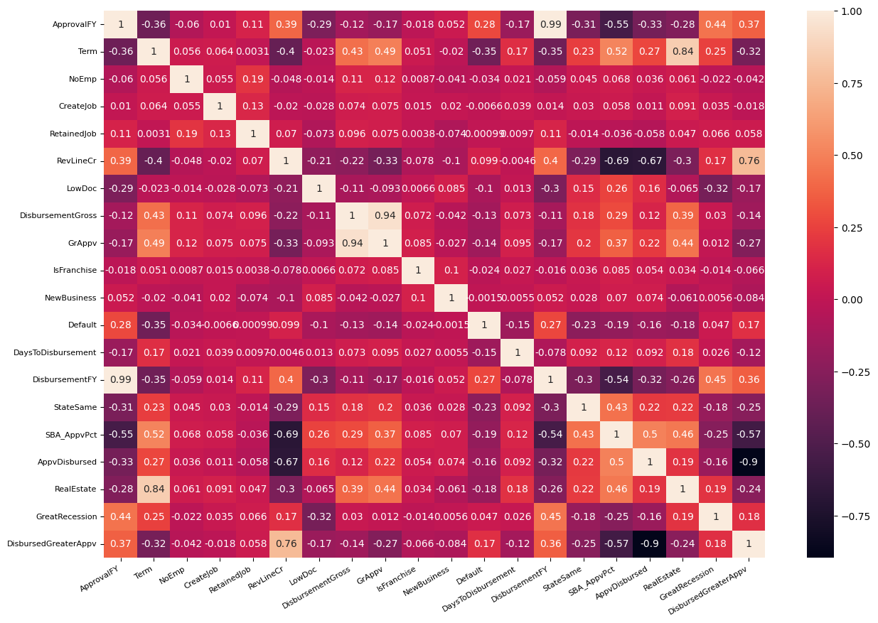
Data Visualization

Slide 10
Strong correlation expected, as disbursed amounts typically align closely with approved loan amounts.
DisbursedGreaterAppv & AppvDisbursed (Negative):
When disbursed > approved, the direct relationship breaks, resulting in negative correlation.
RevLineCr & DisbursedGreaterAppv (Positive):
Consistent with revolving credit behavior—businesses often draw more over time than initially approved.
SBA_AppvPct & RevLineCr (Negative):
Likely due to loan type—SBA Express (lower guarantee %, quicker approval) commonly used for revolving lines.
DisbursementFY & ApprovalFY (Positive):
Logical pattern—loans are often disbursed in the same fiscal year they’re approved.

Slide 11
Graphical Distribution of the data
Total/Average disbursed loan amount by industry.
Average days to disbursement by industry.
Number of paid in full and defaulted loans by industry.
Number of paid in full and defaulted loans by Approval FY.
Number of paid in full and defaulted loans by State.
Percentage of defaulted loans backed by Real Estate.
Percentage of defaulted loans active during the Great Recession.

Slide 12
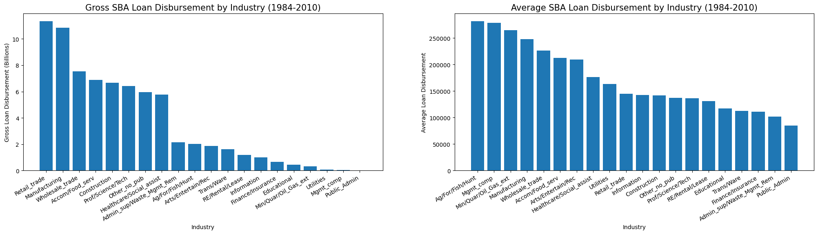

Slide 13
Explanation
Retail Trade and Manufacturing industries received the largest total loan distributions during the sample period.
Agriculture, Mining, and Management industries had relatively fewer loans, but the highest average loan amounts.
This indicates that these sectors received a small number of large-sized loans, unlike others with broader distribution.

Slide 14
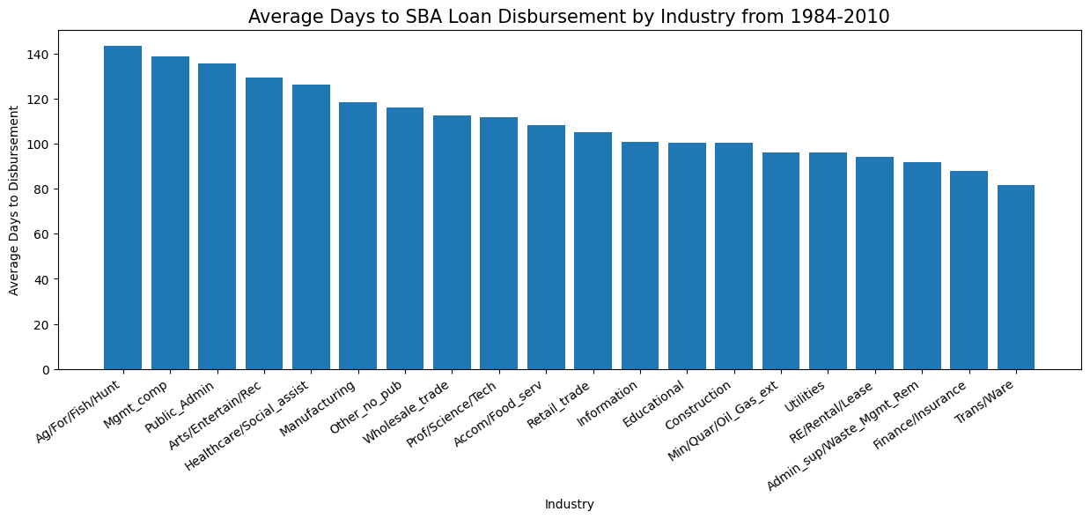

Slide 15
Explanation
Industries like Agriculture and Management of Companies had the highest average loan amounts.
These same industries also experienced the longest delays in fund disbursement, suggesting a possible link between loan size and processing time.

Slide 16
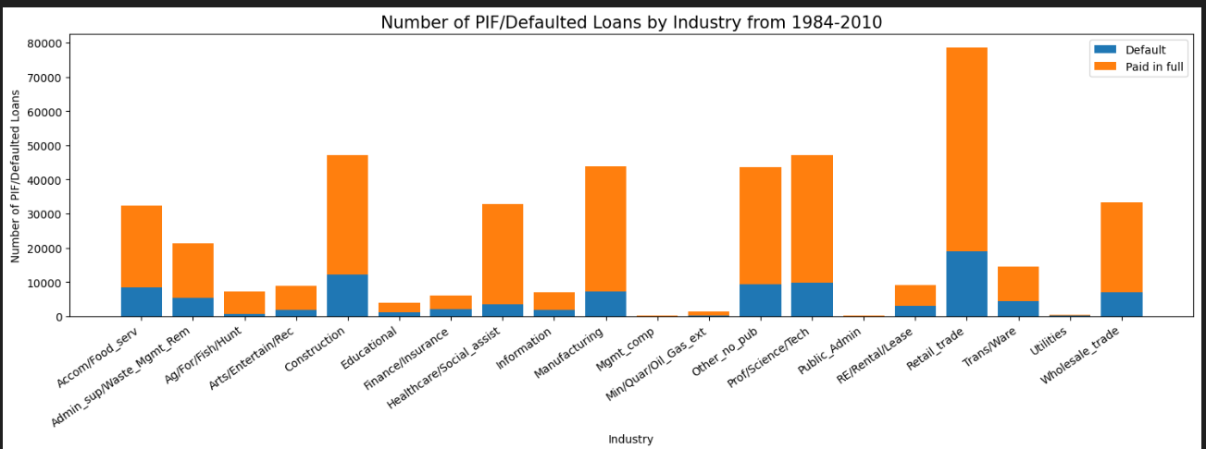

Slide 17
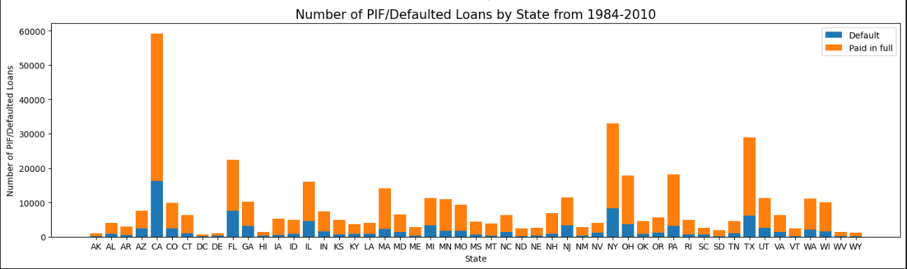

Slide 18
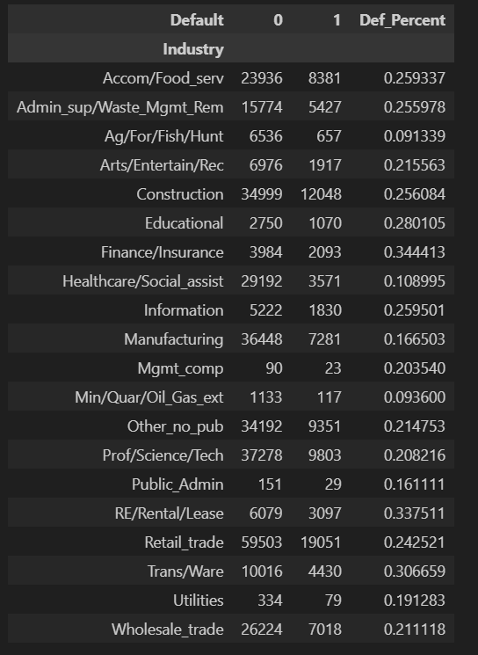
Check default % per industry

Slide 19
Industries with the highest number of loans during sample period: Retail trade (78,554), Professional, scientific and technical services (47,081) and Construction (47,047)
Industries with the highest Default percentage: Finance and Insurance (34.4%), Real Estate and rental leasing (33.8%) and Transportation and warehousing (30.7%)
States with the highest number of loans during sample period: California (59,121), New York (33,059) and Texas (28,941)
State with the highest Default percentage: Florida (33.8%), Arizona (32.6%) and Nevada (31.6%)

Slide 20
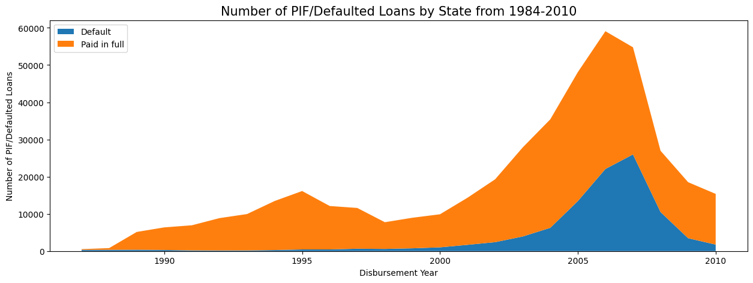
There is a clear increase in loan volume leading up to the peak of the Great Recession, with a subsequent drop in loan volume immediately following that time. Looking at the graph, it appears the default rate of loans increased during that time as well.

Slide 21
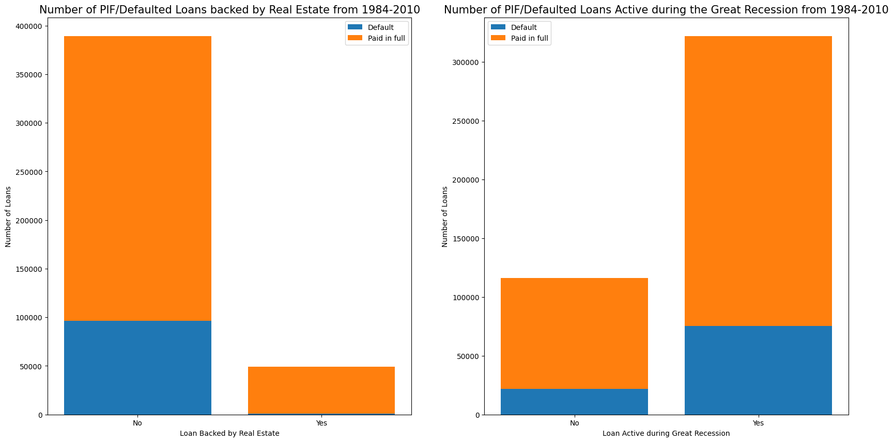

Slide 22
Modeling
Models Used: Logistic Regression and XGBoost – chosen for interpretability and strong performance in classification tasks.
Encoding technique used: One hot encoding for categorical variables.
Evaluation Approach: Accuracy alone isn't sufficient; focus on precision, recall, and F1-score.
Business Context Matters: Predicting a default that doesn’t happen is better than missing an actual default.
Goal: Minimize false negatives to reduce risk exposure in loan approvals.

Slide 23
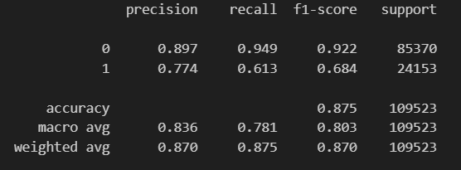
Model implementation
We can see here that with the Logistic Regression model, we have a decent accuracy at 87.5%, however the F1-score of 68.4% for defaulted loans does not seem very promising. The precision suggests that the model is correct 78.2% of the time when the loan defaults, and the recall suggests that the model identifies 60.8% of defaulted loans correctly. That means that 39.2% of loans that defaulted were incorrectly classified as loans that would be paid in full, which is NOT very good.

Slide 24
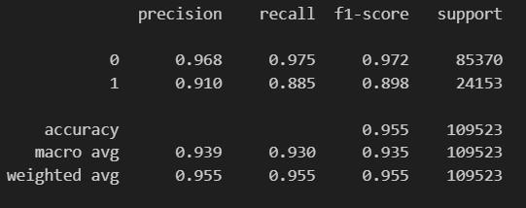
XGBoost classifier
This is MUCH better across the board! Not only do we have a general accuracy of 95.6%, but also the precision, recall and F1-score are all improved by quite a bit.
Let's take a look at some of the most important features.

Slide 25
Feature Importance's
Top Influential Features: Term, StateSame, ApprovalFY, UrbanRural_1 (Urban), and BankState_NC were the top five features impacting loan default prediction.
Industry Insights: Healthcare/Social Assistance had the highest impact; while Mgmt_comp, Public_Admin, and Utilities had the least.
Unexpected Observations: Real Estate backing and loan activity during the Great Recession showed negligible importance.
Business Age: Whether a business was new or established had little impact on default prediction.

Slide 26
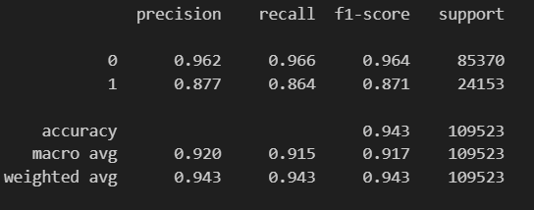
Build pipeline for feature selection and modeling
SelectKBest defaults set to top 10 features.

Slide 27
Conclusion
Performed extensive exploratory data analysis to understand loan distribution, industry-wise trends, and default rates.
Identified strong correlations between approval amounts, disbursement values, credit lines, and default behavior.
Built classification models using Logistic Regression and XGBoost to predict loan defaults.
Evaluated models beyond accuracy using precision, recall, and F1-score due to the imbalanced nature of default outcomes.
Discovered key features influencing defaults, such as loan term, location consistency (State_Same), fiscal year of approval, and urban location.

Slide 28
Next steps & future scope
Fine-tune models using hyperparameter optimization (GridSearchCV or RandomizedSearchCV).
Explore other advanced ML models like Random Forest, LightGBM, or ensemble methods for better prediction performance.
Integrate external datasets (e.g., economic indicators or credit scores) to enrich feature space.
Deploy the final model into a dashboard for real-time loan default risk assessment and monitoring.

Slide 29
Thank You

